Slide 1
Convolutional Neural Networks
Most material from Andrew NG’s Course at Coursera

Slide 2
Outline
Computer Vision Problems
Edge Detection
Padding
Stride
Convolution over Volume
Multiple Filters
Pooling Layer
Why Convolutions
LeNet-5

Slide 3
Computer Vision Problems

Slide 4

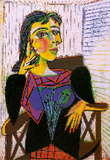
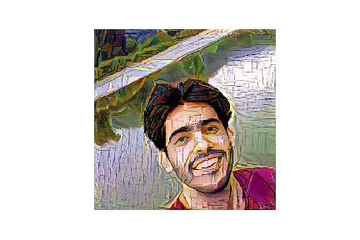
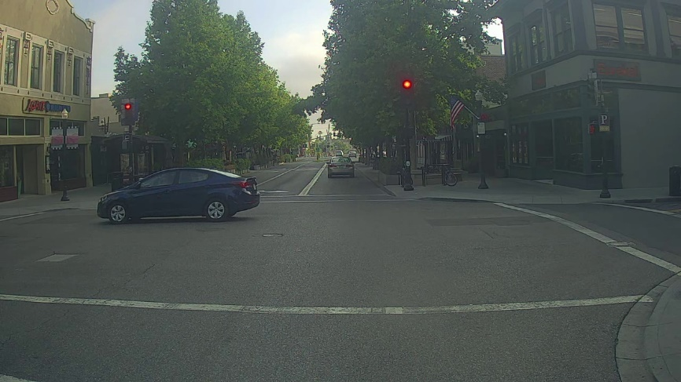
Computer Vision Problems
Image Classification
Neural Style Transfer
Cat? (0/1)
64x64
Object detection

Slide 5

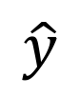
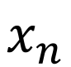
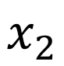
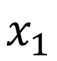

Deep Learning on large images
Cat? (0/1)
64x64
$$x_{1}$$
$$x_{2}$$
$$⋮$$
$$⋮$$
$$⋮$$
$$\hat{y}$$
$$x_{n}$$

Slide 6
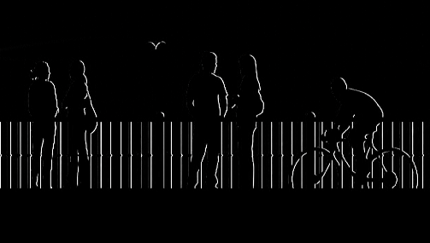
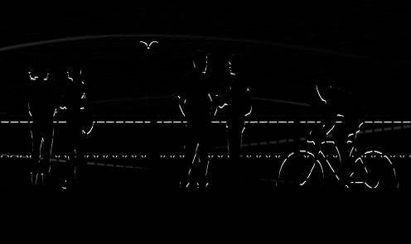
Computer Vision Problem
vertical edges
horizontal edges

Slide 7
Edge Detection

Slide 8
Vertical edge detection
1
1
-1
0
1
1
0
-1
-1
-1
0
0
3 | 0 | 1 | 2 | 7 | 4
1 | 5 | 8 | 9 | 3 | 1
2 | 7 | 2 | 5 | 1 | 3
0 | 1 | 3 | 1 | 7 | 8
4 | 2 | 1 | 6 | 2 | 8
2 | 4 | 5 | 2 | 3 | 9
1
1
1
1
1
0
-1
0
-1
1
0
-1
1
1
0
-1
0
-1
-1
-1
-1
0
0
0
1 | 0 | -1
1 | 0 | -1
1 | 0 | -1
1
1
1
1
0
-1
0
0
-1
1
0
0
-1
-1
1
-1
1
0
-1
1
0
-1
0
-1
$$∗$$
$$=$$
1
0
-1
1
0
-1
1
1
0
-1
0
-1
0 | -2 | -4 | -7
-3 | -2 | -3 | -16
formula:

Slide 9


Vertical edge detection
10 | 10 | 10 | 0 | 0 | 0
10 | 10 | 10 | 0 | 0 | 0
10 | 10 | 10 | 0 | 0 | 0
10 | 10 | 10 | 0 | 0 | 0
10 | 10 | 10 | 0 | 0 | 0
10 | 10 | 10 | 0 | 0 | 0
0 | 30 | 30 | 0
0 | 30 | 30 | 0
0 | 30 | 30 | 0
0 | 30 | 30 | 0
1 | 0 | -1
1 | 0 | -1
1 | 0 | -1
$$∗$$
$$=$$
$$∗$$
$$=$$

Slide 10


Learning to detect edges
1 | 0 | -1
1 | 0 | -1
1 | 0 | -1
1 | 0 | -1
2 | 0 | -2
1 | 0 | -1
3 | 0 | -3
10 | 0 | -10
3 | 0 | -3
Sobel
Scharr
3 | 0 | 1 | 2 | 7 | 4
1 | 5 | 8 | 9 | 3 | 1
2 | 7 | 2 | 5 | 1 | 3
0 | 1 | 3 | 1 | 7 | 8
4 | 2 | 1 | 6 | 2 | 8
2 | 4 | 5 | 2 | 3 | 9
$w_{1}$ | $$w_{2}$$ | $$w_{3}$$
$w_{4}$ | $$w_{5}$$ | $$w_{6}$$
$w_{7}$ | $$w_{8}$$ | $$w_{9}$$
$$∗$$
$$=$$

Slide 11
Padding

Slide 12


Padding
Shrink output
Throw away information
1 | 3 | 2 | 1 | 3
2 | 9 | 1 | 1 | 5
1 | 3 | 2 | 3 | 2
8 | 3 | 5 | 1 | 0
5 | 6 | 1 | 2 | 9
1 | 0 | -1
1 | 0 | -1
1 | 0 | -1
$$∗$$
$$=$$
formula:

Slide 13
Valid and Same convolutions
“Valid”: No padding
“Same”: Pad so that output size is the same as the input size.

Slide 14
Stride

Slide 15


Strided convolution
2 | 3 | 7 | 4 | 6 | 2 | 9
6 | 6 | 9 | 8 | 7 | 4 | 3
3 | 4 | 8 | 3 | 8 | 9 | 7
7 | 8 | 3 | 6 | 6 | 3 | 4
4 | 2 | 1 | 8 | 3 | 4 | 6
3 | 2 | 4 | 1 | 9 | 8 | 3
0 | 1 | 3 | 9 | 2 | 1 | 4
3
4
4
3
4
3
4
4
4
1
0
2
1
0
1
2
0
2
-1
0
3
4
4
91 | 100 | 83
69 | 91 | 127
44 | 72 | 74
-1
3
0
-1
3
4
4
3
0
3
3 | 4 | 4
1 | 0 | 2
-1 | 0 | 3
3
4
4
1
0
1
0
2
$$=$$
2
1
0
2
$$∗$$
-1
0
3
-1
0
3
4
4
3
-1
0
3
3
4
4
3
4
4
1
0
2
1
0
2
1
0
2
-1
0
3
-1
0
3
-1
0
3
formula:
What about odd numbers:

Slide 16
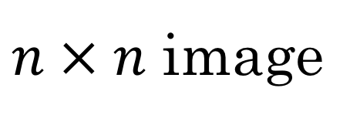
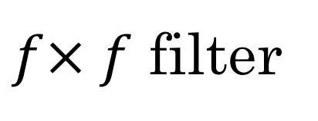
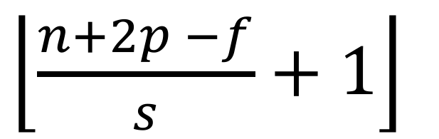
Summary of convolutions
$n × n$ image
$f× f$ filter
padding p
stride s
$\left\lfloor \frac{n+2p −f}{s}+1\right\rfloor$
$\left\lfloor \frac{n+2p −f}{s}+1\right\rfloor$
$$×$$

Slide 17
Convolution over Volume

Slide 18

Convolutions on RGB image
$$∗$$
$$=$$
3 x 3 x 3
4 x 4
6 x 6 x 3
1 | 0 | -1
1 | 0 | -1
1 | 0 | -1
0 | 0 | 0
0 | 0 | 0
0 | 0 | 0
0 | 0 | 0
0 | 0 | 0
0 | 0 | 0
Vertical edge detector in red channel
1 | 0 | -1
1 | 0 | -1
1 | 0 | -1
1 | 0 | -1
1 | 0 | -1
1 | 0 | -1
1 | 0 | -1
1 | 0 | -1
1 | 0 | -1
Vertical edge detector in any channel

Slide 19
Multiple Filters

Slide 20


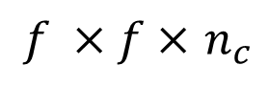

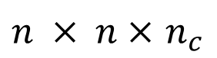


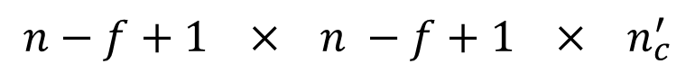
Multiple filters
$$∗$$
$$=$$
3 x 3 x 3
4 x 4
$$∗$$
$$=$$
4 x 4 x 2
6 x 6 x 3
3 x 3 x 3
4 x 4
$n × n×$ $n_{c}$
$$∗$$
$f ×f×$ $n_{c}$
$$n−f+1 × n −f+1 × n_{c}^{′}$$
Summary:

Slide 21




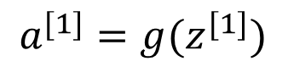
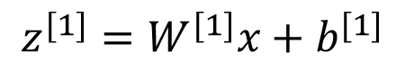
Example of a Layer
$$∗$$
$$=$$
3 x 3 x 3
4 x 4
4 x 4
$$∗$$
$$=$$
6 x 6 x 3
3 x 3 x 3
4 x 4
4 x 4
$$z^{[1]}=W^{[1]}x+b^{[1]}$$
$$a^{[1]}=g(z^{[1]})$$
4 x 4 x 2

Slide 22
Number of parameters in one layer:
If you have 10 filters that are 3 x 3 in one layer of a CNN, which it’s input is RGB image, how many parameters does that layer have?

Slide 23
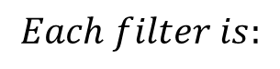
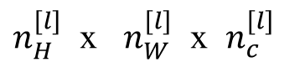
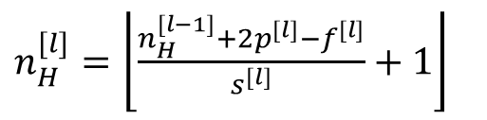
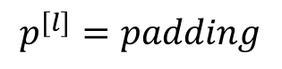
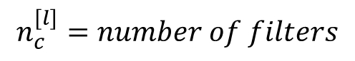
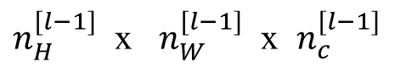
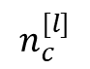
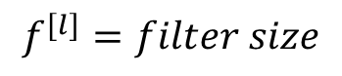
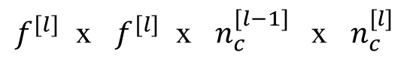
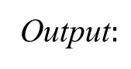
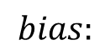
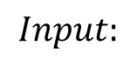
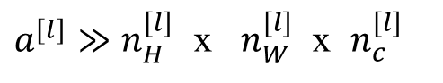
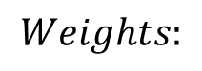
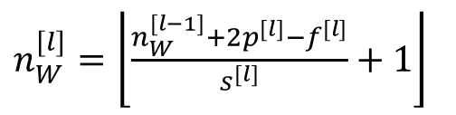
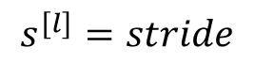
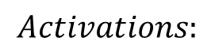
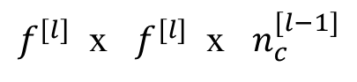
Summary of notation
If layer 1 is a convolution layer:
$$f^{[l]}=filter size$$
$$p^{[l]}=padding$$
$$Input:$$
$n_{H}^{[l−1]}$ x $n_{W}^{[l−1]}$ x $n_{c}^{[l−1]}$
$$s^{[l]}=stride$$
Output$:$
$n_{H}^{[l]}$ x $n_{W}^{[l]}$ x $n_{c}^{[l]}$
$$n_{c}^{[l]}=number of filters$$
$$Each filter is:$$
$f^{[l]}$ x $f^{[l]}$ x $n_{c}^{[l−1]}$
$n_{H}^{[l]}=\left\lfloor \frac{n_{H}^{[l−1]}+2p^{[l]}−f^{[l]}}{s^{[l]}}+1\right\rfloor$
$$Activations:$$
${a^{[l]}≫n}_{H}^{[l]}$ x $n_{W}^{[l]}$ x $n_{c}^{[l]}$
$n_{W}^{[l]}=\left\lfloor \frac{n_{W}^{[l−1]}+2p^{[l]}−f^{[l]}}{s^{[l]}}+1\right\rfloor$
$$Weights:$$
$f^{[l]}$ x $f^{[l]}$ x $n_{c}^{[l−1]} \text{x} n_{c}^{[l]}$
$$bias:$$
$$n_{c}^{[l]}$$

Slide 24
Pooling Layer

Slide 25
Pooling Layer
Reduce the size of representation
Speed up computation
Make some of features it detects a bit robust

Slide 26
Pooling layer: Max pooling
1 | 3 | 2 | 1
2 | 9 | 1 | 1
1 | 3 | 2 | 3
5 | 6 | 1 | 2
Hyper-parameters:
s = 2
f = 2

Slide 27
Pooling layer: Max pooling
1 | 3 | 2 | 1 | 3
2 | 9 | 1 | 1 | 5
1 | 3 | 2 | 3 | 2
8 | 3 | 5 | 1 | 0
5 | 6 | 1 | 2 | 9
Hyper-parameters:
s =
f =
Max Pooling is done independently on each of the channels

Slide 28
Pooling layer: Average pooling
1 | 3 | 2 | 1
2 | 9 | 1 | 1
1 | 4 | 2 | 3
5 | 6 | 1 | 2
3.75
1.25
4
2

Slide 29
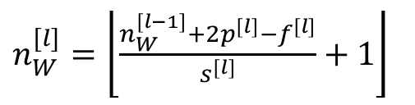
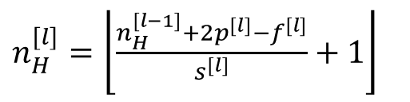
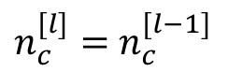
Summary of pooling
Hyperparameters:
f : filter size
$n_{c}^{[l]}=$ $n_{c}^{[l−1]}$
s : stride
Max or average pooling
$n_{H}^{[l]}=\left\lfloor \frac{n_{H}^{[l−1]}+2p^{[l]}−f^{[l]}}{s^{[l]}}+1\right\rfloor$
p : padding
$n_{W}^{[l]}=\left\lfloor \frac{n_{W}^{[l−1]}+2p^{[l]}−f^{[l]}}{s^{[l]}}+1\right\rfloor$
There is no parameters to learn!!!

Slide 30
Why Convolutions

Slide 31


Why convolutions
10 | 10 | 10 | 0 | 0 | 0
10 | 10 | 10 | 0 | 0 | 0
10 | 10 | 10 | 0 | 0 | 0
10 | 10 | 10 | 0 | 0 | 0
10 | 10 | 10 | 0 | 0 | 0
10 | 10 | 10 | 0 | 0 | 0
0 | 30 | 30 | 0
0 | 30 | 30 | 0
0 | 30 | 30 | 0
0 | 30 | 30 | 0
1 | 0 | -1
1 | 0 | -1
1 | 0 | -1
$$∗$$
$$=$$
Parameter sharing: A feature detector (such as a vertical edge detector) that’s useful in one part of the image is probably useful in another part of the image.
Sparsity of connections: In each layer, each output value depends only on a small number of inputs.

Slide 32
Why convolutions
CNN has lot few parameters
Needs less training examples
It is less prone to over-fitting

Slide 33
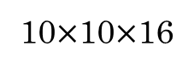

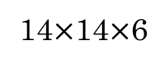

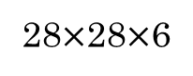
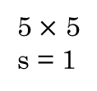
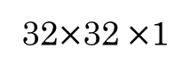
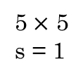
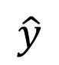
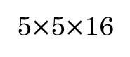
LeNet - 5
avg pool
avg pool
$$\hat{y}$$
5$×$ 5
s = 1
f = 2
s = 2
5$×$ 5
s = 1
f = 2
s = 2
$$⋮$$
$$⋮$$
32$×$32 $×$1
28$×$28$×$6
14$×$14$×$6
10$×$10$×$16
5$×$5$×$16
120
84
[LeCun et al., 1998. Gradient-based learning applied to document recognition]

